Slide 1
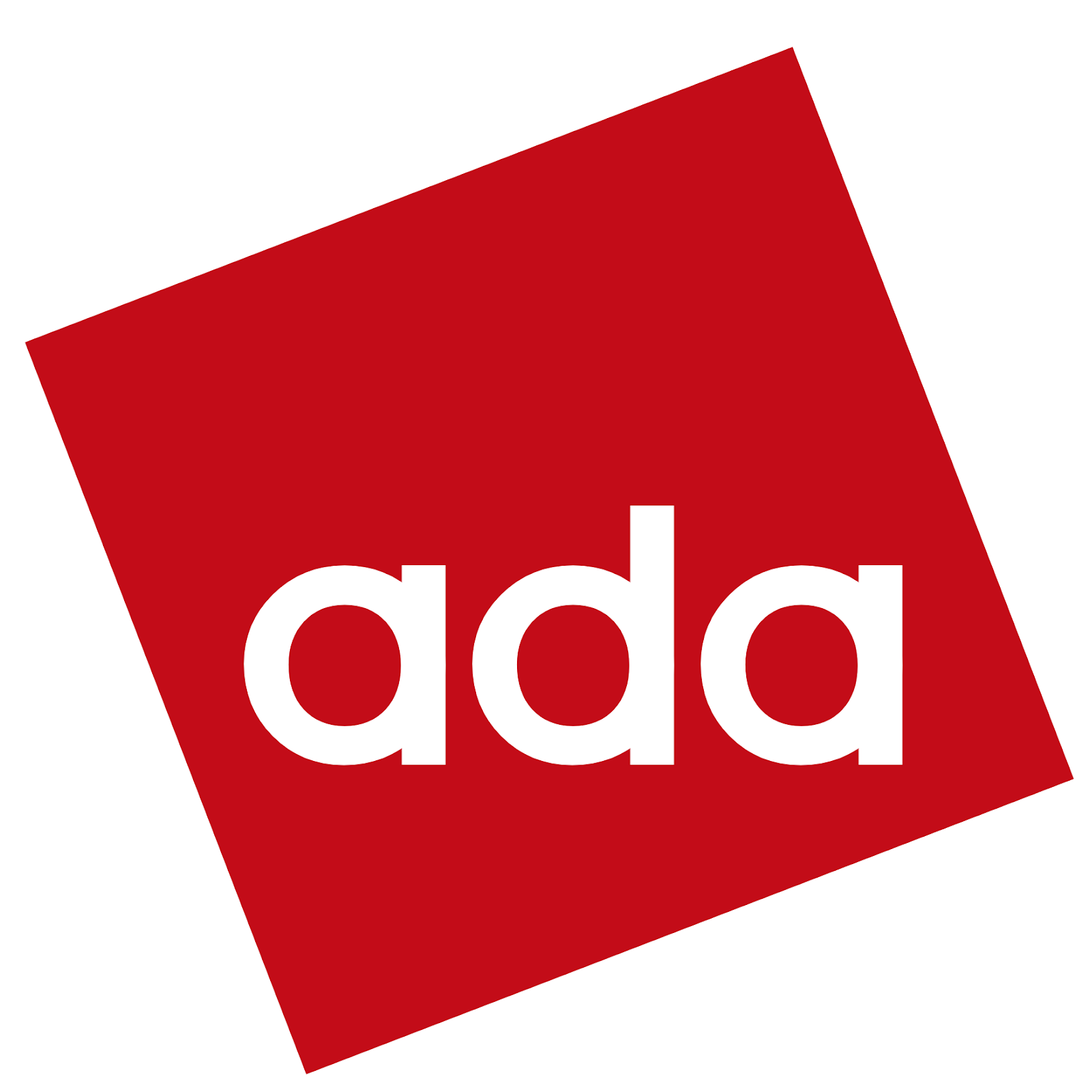

The Hitchhiker’s Guide … to Spark
Notes:
Hello and welcome to the next tutorial of ADA. Today, the menu has Spark.
Let’s first get some common ground though. How many of you have heard the term big data?

Slide 2
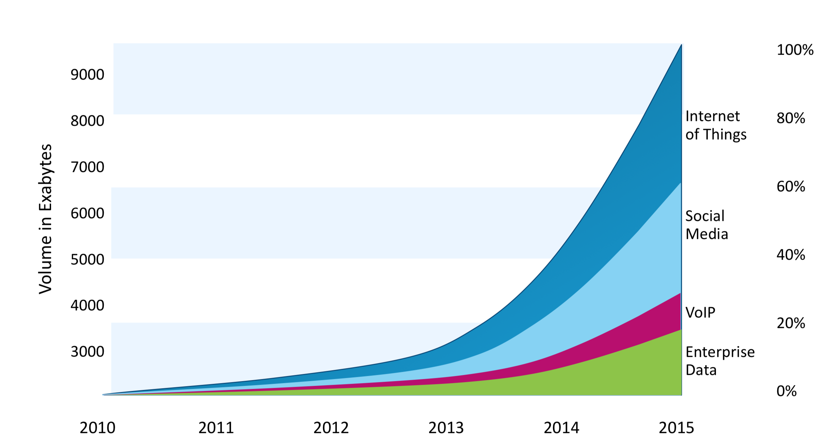
Scalability in the Era of the Data Deluge
Single Server: insufficient memory capacity
and computational resources
🤔
Why not use many machines?
Source: HYPERconnected Enterprise Briefings 2014, IBM
We need to scale out...
Notes:
Good! And rightfully so.
Because in the past decade or so, data has been growing exponentially
In fact, I have appended a graph from IBM, from 2014 that shows the trend. It’s still the same. We are in the dozen zettabytes by now.
As Bob said yesterday, we want to use as much data as we can get, but a single server has limited memory capacity and computational resources (even big ones)
So, should we just quit? Nah, thankfully we have plenty of servers but we have to program in a distributed way

Slide 3





The Hadoop Ecosystem
Notes:
In this context, a whole family of technologies have emerged to allow scale-out processing.
The common denominator is the HDFS, the distributed file system.
And on top of it, we have different engines…
We will focus on spark

Slide 4
Architecture of Spark
Spark SQL
Spark Streaming
MLib
GraphX
Spark Core
Standalone Scheduler
YARN
Mesos
Notes:
But let’s take a peek at the architecture of Spark before we go hands-on
On the bottom, we have different utilities, the cluster managers, that perform scheduling and resource management.
On top of that, we have Spark Core, which provides the Spark functionality and the RDD API we talked about.
And on an even higher level, we have different technologies.

Slide 5
Architecture of Spark
Spark SQL
Spark Streaming
MLib
GraphX
Spark Core
Standalone Scheduler
YARN
Mesos
Notes:
In this tutorial we will talk about this diagonal over here, starting bottom up

Slide 6
Yarn: Yet Another … Cluster Manager
Y A R N
manages resources&scheduling
allow multiple engines
“Data Operating System”
Notes:
Let’s start with yarn, with which you will concern yourself the least for the time being
Yarn is the module that allows scheduling and resource management in our ecosystem.
It sits between our engines and HDFS and in fact facilitates the use of multiple engines and multi-tenancy.
While I was preparing these slides, I found out that some use the term “Data Operating System” which is not exactly correct but I think it is an interesting perspective.

Slide 7
Everything you don’t need to know about YARN
schedule jobs &
allocate resources
Node
Manager
monitor resource use
client
container
AppMngr
Resource
Manager
Node
Manager
client
container
AppMngr
Node
Manager
resource abstraction
executed by node
negotiates with resource manager
container
AppMngr
TLDR: Use YARN for cluster (--master yarn)
Notes:
And to dive slightly deeper, although this information is not too critical right now,
YARN has 4 components: 1) 2) 3) 4)
In short, when you run stuff on the cluster, you will need yarn. And then you should use the master yarn argument. I am serious about that.

Slide 8
Spark Core
Expose RDD API: functional paradigm
val conf = new SparkConf().setAppName("wiki_test")
val sc = new SparkContext(conf)
val data = sc.textFile("somedir")
val tokens = data.flatMap(_.split(" "))
val wordFreq = tokens.map((_, 1)).reduceByKey(_ + _)
wordFreq.sortBy(s => -s._2).map(x => (x._2, x._1)).top(10)
Driver program
Normal script
Initiates parallel ops
Can run in cluster/client
Spark’s cornerstone, underlying layer
Notes:
Ok, let’s go one level above. Phew!
The Spark core exposes the RDD API which improves programmability. The programming paradigm is functional.
In any case, everything is built on top of this Spark module.
Here I have a code snippet which is in Scala. We won’t use scala, but you get the poit that it looks like a normal program.
This is the driver program. Here we initiate parallel operations, highlighted with orange.
We can choose to run it in the cluster or the client, depends on what we want to do.

Slide 9
Spark SQL
Often the data is structured and has a schema
Spark provides a DataFrame abstraction with Spark SQL
DSL and SQL support for data manipulations, declarative
Allows for Query Optimization (Catalyst)
result = spark.sql(“ select sid, count(*) as cnt \
from sailors \
inner join reserves on sailors.sid = reserves.sid \
inner join boat on boat.bid = reserves.bid \
where level > 5 and color = ‘red’ \
group by sid \
having count(distinct bid) \
order by cnt \
limit 10”)
Powerful tool for complex analytics
Notes:
And the last thing we will talk about is spark sql.
We use it when our data is structured, that is, they have schema.
Then we can use DataFrames and work with their methods or sql.
And to makes things better we have an actual query optimizer working below the surface. Yes, lazy execution does some optimization but we are talking 50 years of research here.

Slide 10
DEMO
TIME
Notes:
Now, shall we get practical? ☺

